Slide 1


DPR TERMINOLOGY

Slide 2
CHAPTER 1 – Recap
Goal :
To understand the difference between static and dynamic and to establish a common understanding of Full Reconfiguration and Partial Reconfiguration.

Slide 3
Full Reconfiguration vs Partial Reconfiguration
Full Reconfiguration
Partial Reconfiguration
Entire FPGA is reconfigured
Existing hardware stops functioning
Whole configuration memory is rewritten
Longer downtime
Larger bitstream
Only selected FPGA region is updated
Remaining hardware continues running
Smaller bitstream
Faster update
Reduced system downtime

Slide 4
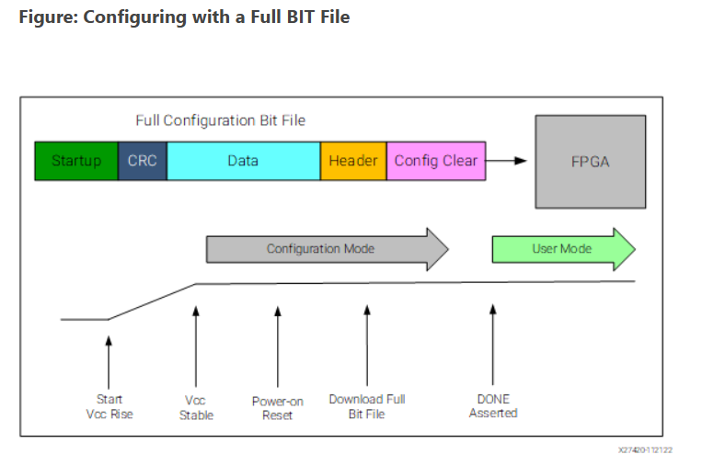
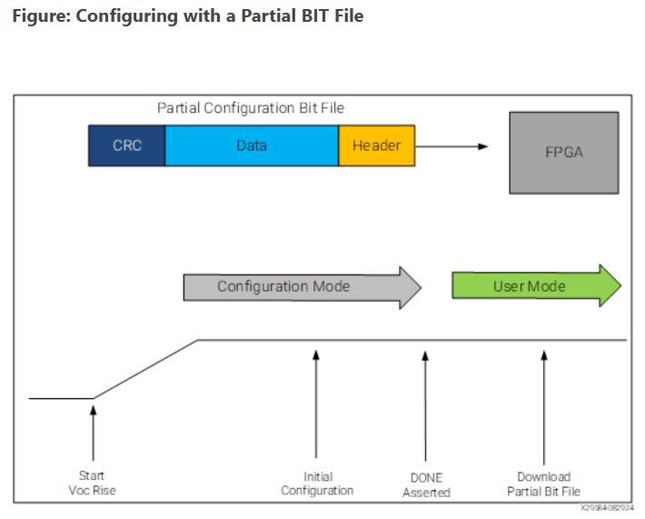
FULL RECONFIGURATION
PARTIAL RECONFIGURATION

Slide 5
STATIC vs DYNAMIC
Static Partial Reconfiguration
Dynamic Partial Reconfiguration
Target region updated after stopping the system
System operation is interrupted
Simpler update process
Not suitable for applications requiring continuous operation
Target region updated while the rest of the FPGA continues running
Minimal downtime
Enables runtime hardware changes
Ideal for high-availability and adaptive systems

Slide 6
CHAPTER 2 – Static Region & Reconfigurable Region
Goal :
To understand that Dynamic Partial Reconfiguration is possible because we intentionally divide the FPGA into two different regions with different responsibilities.

Slide 7
Why Divide the FPGA?
Problem
Reloading the entire FPGA for a small hardware change is inefficient.
Critical hardware should remain operational during updates.
Many applications require continuous operation.
Solution
Divide the FPGA into :
Static Region (remains unchanged)
Reconfigurable Region (can be updated)
Benefit
Faster updates
Reduced downtime
Adaptive hardware functionality

Slide 8
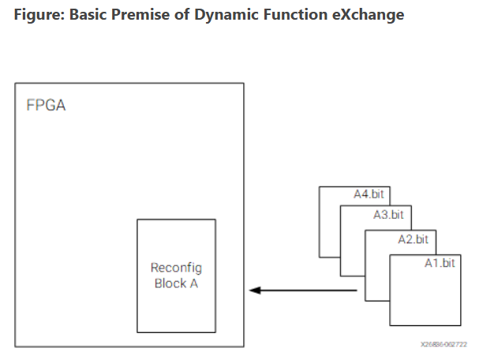

Slide 9
CHAPTER 3 – Reconfigurable Partition (RP) & Reconfigurable Module (RM)
Goal :
To help the audience understand the difference between a Reconfigurable Partition (RP) and a Reconfigurable Module (RM), explaining how a fixed reconfigurable partition can host different hardware modules over time, enabling Dynamic Partial Reconfiguration without affecting the rest of the FPGA.

Slide 10
Reconfigurable Partition (RP)
Definition :
A Reconfigurable Partition is a reserved logical portion of the FPGA design whose functionality can be changed during Dynamic Partial Reconfiguration.
Key Characteristics :
Fixed during design
Acts as a container for reconfigurable hardware
Protects the Static Region
Enables runtime hardware replacement
Can host different Reconfigurable Modules over time

Slide 11
Reconfigurable Module (RM)
Definition :
A Reconfigurable Module (RM) is a hardware implementation that occupies a Reconfigurable Partition (RP). Different RMs can be loaded into the same RP during runtime using Dynamic Partial Reconfiguration.
Key Characteristics :
Implements a specific hardware function
Occupies a Reconfigurable Partition
Can be replaced without affecting the Static Region
Each RM has its own Partial Bitstream
Only one RM is active in an RP at any given time

Slide 12
CHAPTER 4 – Bitstreams & Configuration Frames
Goal :
To introduce the different types of FPGA bitstreams and explain how FPGA configuration memory is organized into configuration frames, forming the foundation for Dynamic Partial Reconfiguration.

Slide 13
FPGA Bitstreams
A bitstream is a configuration file used to program an FPGA.
It defines the hardware functionality of the FPGA.
Generated after synthesis and implementation.
Two main types:
Full Bitstream
Partial Bitstream
Key Takeaway :
A bitstream tells the FPGA how to configure its hardware.

Slide 14
Full Bitstream
Configures the entire FPGA.
Used during initial FPGA configuration.
Programs both:
Static Region
Reconfigurable Region
Largest configuration file.
Key Takeaway :
A Full Bitstream configures the complete FPGA.

Slide 15
Partial Bitstream
Configures only the Reconfigurable Partition.
Leaves the Static Region unchanged.
Smaller than a Full Bitstream.
Enables Dynamic Partial Reconfiguration.
Key Takeaway :
A Partial Bitstream updates only the reconfigurable hardware.

Slide 16
Full Bitstream vs Partial Bitstream
Full Bitstream | Partial Bitstream
Configures entire FPGA | Configures only RP
Used during startup | Used during runtime
Larger file size | Smaller file size
Longer configuration time | Faster configuration
Updates Static + RP | Updates only RP

Slide 17
Configuration Memory
Stores FPGA configuration data.
Controls FPGA resources such as:
LUTs
Flip-Flops
Routing
BRAM
DSP
Updated using bitstreams.
Key Takeaway :
Configuration memory determines the functionality of the FPGA.

Slide 18
Configuration Frames
Smallest addressable unit of FPGA configuration memory.
Stores configuration data for FPGA resources.
Partial Reconfiguration updates selected frames only.
Frames belonging to the Static Region remain unchanged.
Key Takeaway :
Configuration Frames are the basic units updated during DPR.

Slide 19
CHAPTER 5 – Supporting DPR Concepts
Goal :
To introduce the supporting concepts required for Dynamic Partial Reconfiguration, including Pblocks, Boundary Interfaces, Black Boxes, Partition Pins, and Reconfiguration Controllers.

Slide 20
Floorplanning
Floorplanning is the process of assigning specific physical areas of the FPGA to different parts of the design.
Ensures that the Static Region and Reconfigurable Partition occupy separate physical locations.
Helps organize the FPGA layout.
Provides predictable placement and routing.
Key Takeaway :
Floorplanning organizes the FPGA by assigning dedicated physical areas to different design modules.

Slide 21
Pblock (Physical Block)
A Pblock defines the physical area allocated to a Reconfigurable Partition.
Used for floorplanning in Vivado.
Prevents logic from crossing partition boundaries.
Ensures predictable implementation.
Key Takeaway :
A Pblock reserves a physical area for a Reconfigurable Partition.

Slide 22
Boundary Interface
Connects the Static Region and Reconfigurable Partition.
Provides communication between both regions.
Must remain stable during reconfiguration.
Enables uninterrupted system operation.
Key Takeaway :
Boundary Interfaces allow communication while isolating the reconfigurable hardware.

Slide 23
Black Box
Placeholder used during synthesis.
Internal implementation is temporarily hidden.
Interface remains visible.
Allows independent implementation of Static and Reconfigurable designs.
Key Takeaway :
A Black Box represents a module whose implementation is provided later.

Slide 24
Partition Pins
Virtual connection points between Static Region and RP.
Preserve signal integrity across partition boundaries.
Automatically generated by Vivado.
Maintain consistent routing during DPR.
Key Takeaway :
Partition Pins provide stable communication across partition boundaries.

Slide 25
Reconfiguration Controllers
Controllers used to load bitstreams :
ICAP (Internal Configuration Access Port)
PCAP (Processor Configuration Access Port)
JTAG (External Configuration Interface)
Key Takeaway :
Reconfiguration Controllers transfer Full and Partial Bitstreams into the FPGA.

Slide 26
ICAP vs PCAP vs JTAG
Interface | Location | Typical Use
ICAP | Inside FPGA | Runtime Partial Reconfiguration
PCAP | Processing System | Zynq Configuration
JTAG | External Interface | Programming & Debugging

Slide 27
CHAPTER 6 – Dynamic Partial Reconfiguration Flow
Goal :
To summarize the complete Dynamic Partial Reconfiguration process by connecting all the concepts learned so far and illustrating how hardware is dynamically replaced while the rest of the FPGA continues to operate.

Slide 28
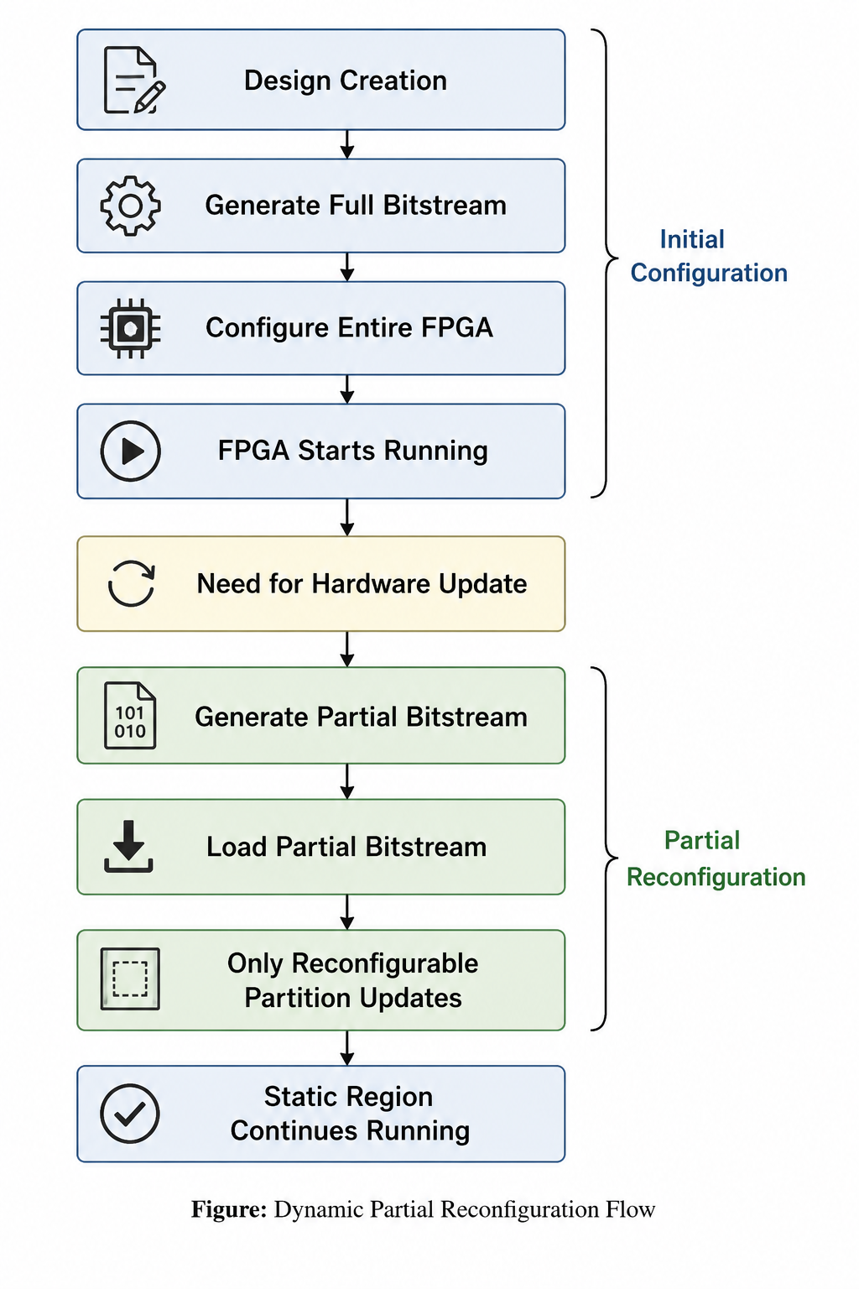

Dynamic Partial Reconfiguration Flow

Slide 29
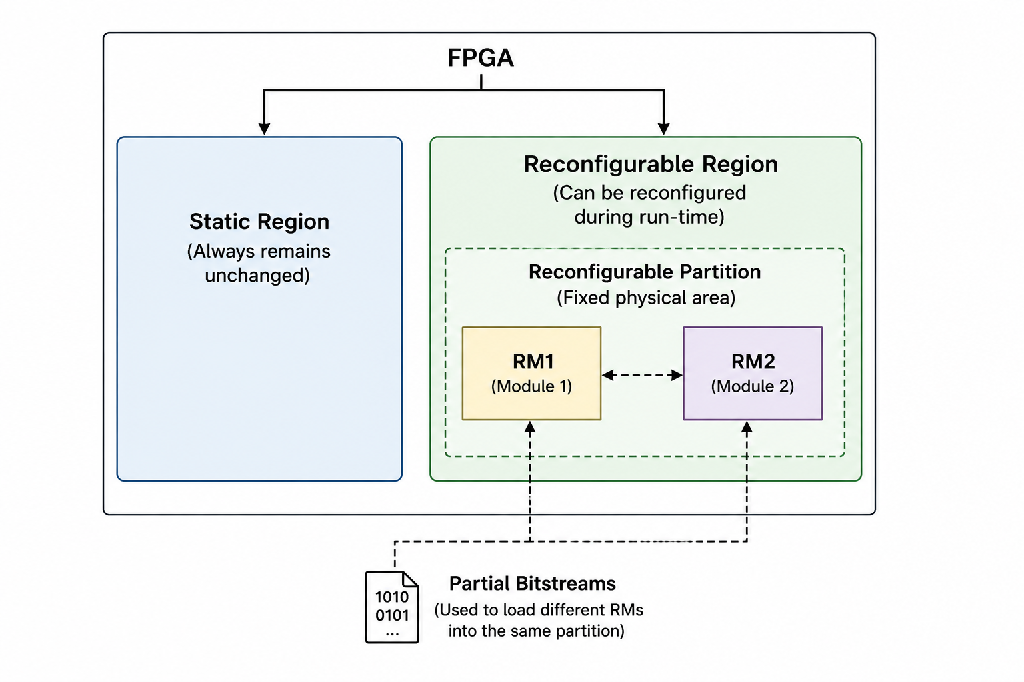

Slide 30
CHAPTER 7 – DPR Terminology Summary
Term | Meaning
Static Region (SR) | Part of the FPGA that never changes during DPR
Reconfigurable Region (RR) | Physical area reserved for dynamic updates
Reconfigurable Partition (RP) | Logical partition that can be reconfigured
Reconfigurable Module (RM) | Hardware implementation loaded into an RP
Full Bitstream | Configures the entire FPGA
Partial Bitstream | Configures only the Reconfigurable Partition
Configuration Memory | Stores FPGA configuration data

Slide 31
Term | Meaning
Configuration Frame | Smallest configurable unit of FPGA configuration memory
Floorplanning | Assigning physical FPGA areas to design modules
Pblock | Physical area reserved for an RP
Boundary Interface | Communication path between Static Region and RP
Black Box | Placeholder module during synthesis
Partition Pins | Stable interface between Static Region and RP
ICAP | Internal configuration interface
PCAP | Processor-based configuration interface
JTAG | External configuration and debugging interface

Slide 32
THANK YOU

